Slide 1
Tourist Guide for Sri Lankan Travelers
Image>>>>>>>>>>

Slide 2

Contents
Contents
Introduction
Overall Description
External Interface Requirements
System Features
Technologies
Research Areas

Slide 3
Introduction
As a very important area tourism produces a major income to a country. As local people we organize tours to visit religious places, natural wonders and various businesses.
If we consider a tourist from a foreign country whenever needed to know locations to visit, he/she needs to relies on local people or internet-based applications. Even then most important information may be lost or even misled.
To approach this challenge, our target is on an internet based mobile solution. These days we hardly find a tourist with a smart phone. They access maps and their current location through the mobile applications. But they are unable to know the important places nearby and their information in Sri Lanka from these solutions.

Slide 4
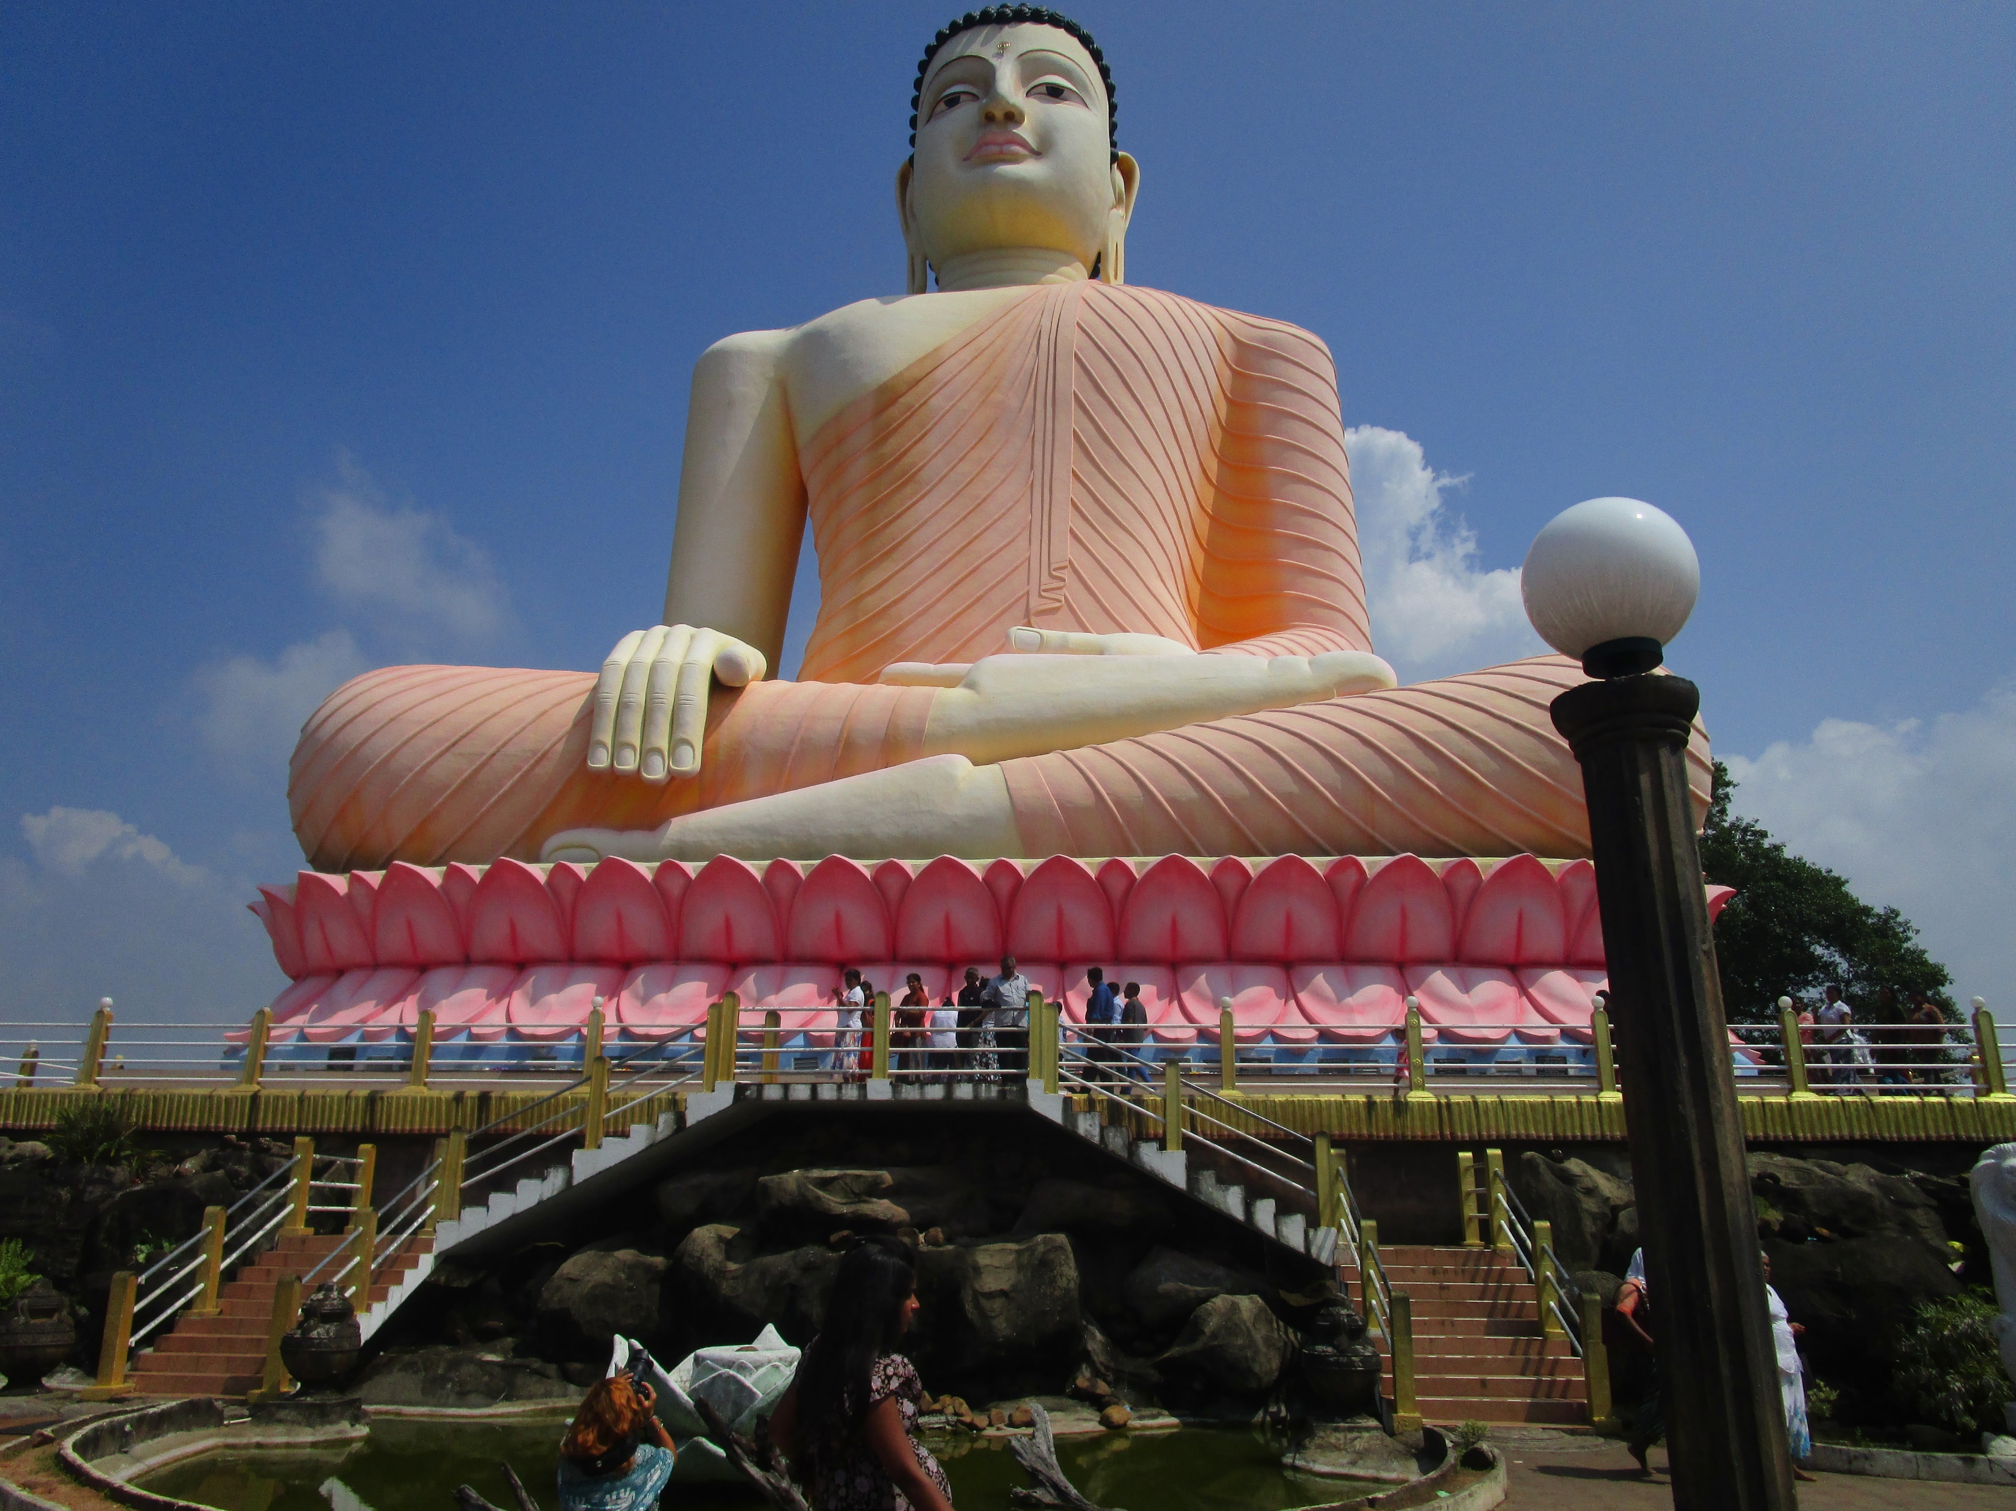
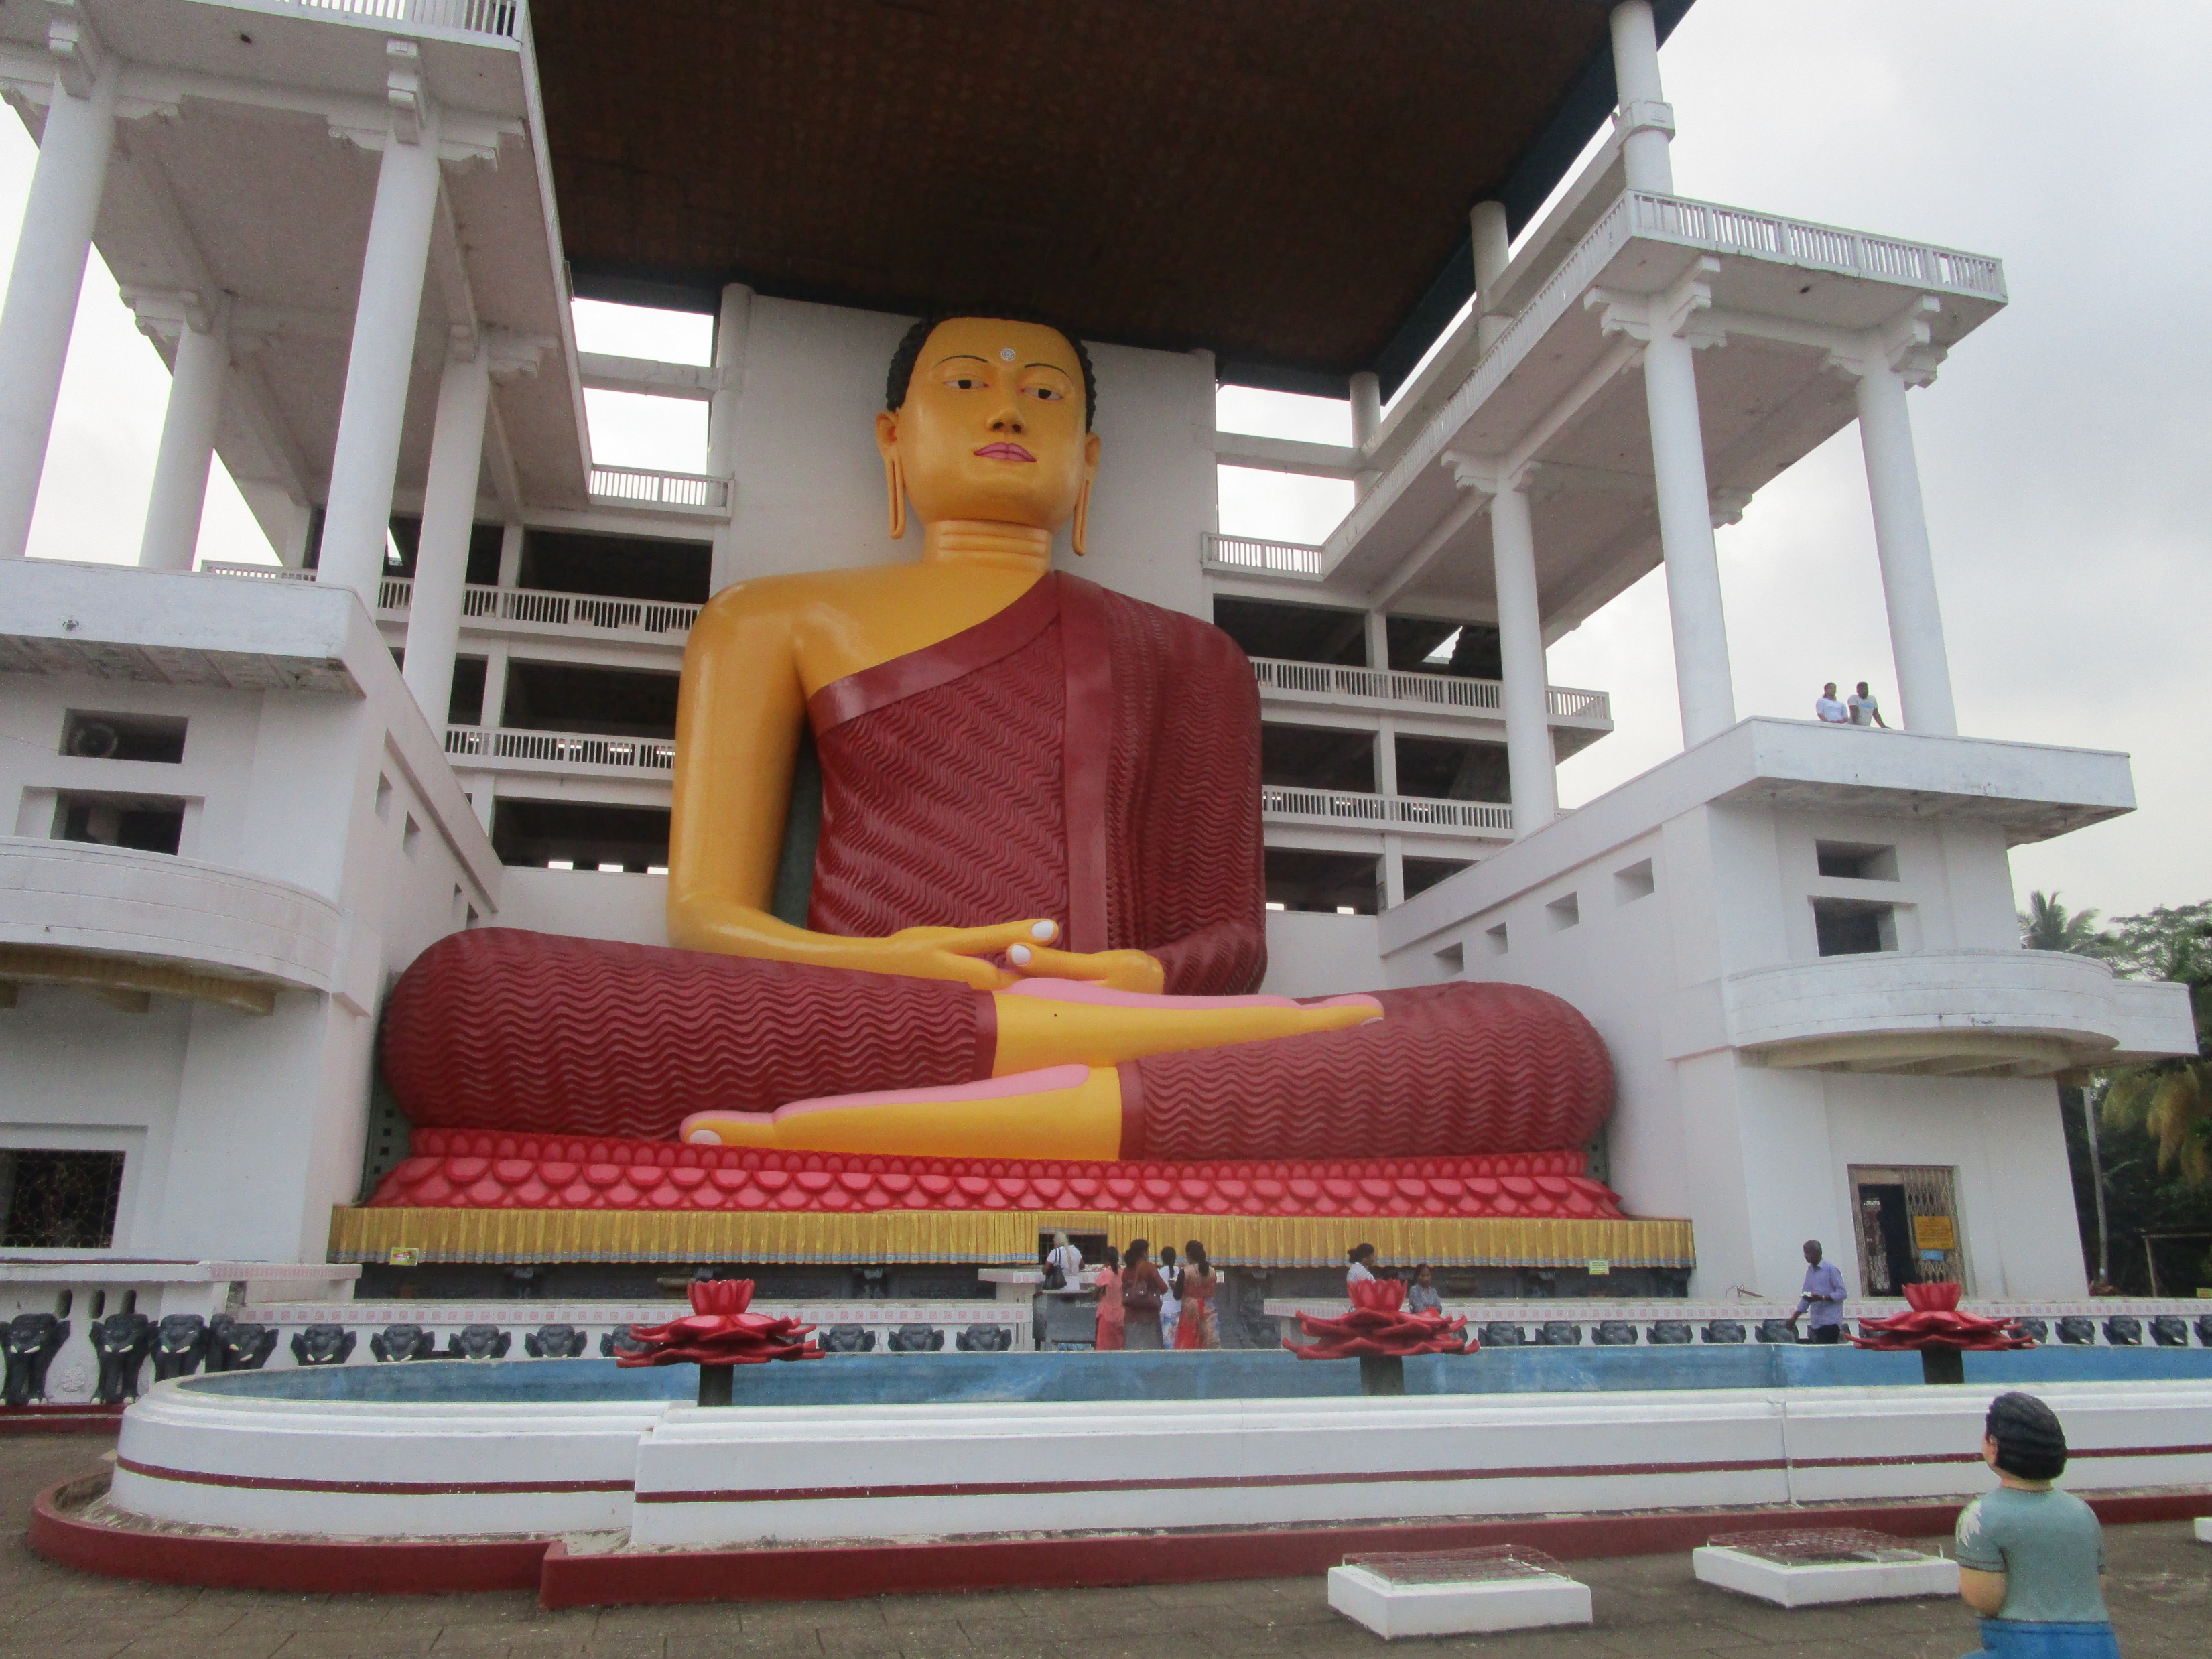
Example
We are expecting to identify nearby monuments on Smart Phone location and provide a narration on them.

Slide 5
Overall Description
Mobile application will be cross platform so that both Android and IOS smart phones can use the application.
Provides a narration on nearby places.
Map view to help and locate the person.
Expecting to develop Augmented Reality based application so that application will give the Route direction through camera.
Capable to change Driving and Walking modes for improve the accuracy on the impact when driving and walking.(Identifying nearby places in a small area or area size by driving speed)
Notes:
Consider talking about:
Definition
Negative impact
Direct environmental impacts
Local people
Case studies

Slide 6
Technologies
This native app will be built through Flutter and con Dart language.
Google Map or alternative Application Programming Interface integrated for location-based information identification and creation.
??for Augmented Reality and Machine Learning>> find

Slide 7
Research Areas
eSociety Research Area
Augmented Reality
Machine Learning

